Slide 1

Exploratory Data Analysis
G2M Cab
November 2023

Slide 2

Agenda
Executive Summary
Problem Statement
Approach
EDA
EDA Summary
Recommendations

Slide 3
Executive Summary
XYZ Company seeks to capitalize on the growth in the US cab industry by strategically entering the market currently dominated by Yellow Cab and Pink Cab. The objective is to conduct a thorough analysis of market trends, customer demographics, and competitive landscapes. Key insights reveal that Yellow Cab holds a significant market share with higher revenues and profit margins, particularly in New York NY. Both companies exhibit seasonality in ride numbers and pricing. Recommendations include a focus on competitive pricing, seasonal adaptation, and geographical expansion, with New York NY identified as a promising location. The report aims to guide XYZ Company in making informed decisions to navigate the complexities of the cab industry, optimize market positioning, and ensure a successful market entry.

Slide 4
Problem Statement
XYZ Company faces the challenge of strategically entering the competitive US cab industry, currently dominated by major players such as Yellow Cab and Pink Cab. The need for a detailed understanding of market dynamics, customer behavior, and competitive strategies arises to make well-informed decisions regarding market entry, pricing strategies, and operational focus. Key areas of concern include gaining a competitive edge, optimizing pricing structures, and identifying opportunities for sustainable growth within the dynamic and evolving cab market.

Slide 5
Approach
1- Competitive Analysis:
Perform a detailed analysis of key competitors, with a focus on Yellow Cab and Pink Cab, to understand their market share, pricing strategies, and operational models.
2- Customer Behavior Study:
data analysis to gain insights into customer demographics, preferences, and behavior within the cab industry.
3- Financial Analysis:
Evaluate financial data to understand revenue streams, profit margins, and overall financial health of Yellow Cab and Pink Cab.
4- Seasonal and Pricing Trends:
Investigate seasonal variations in ride numbers and pricing strategies to identify patterns and inform strategic decision-making.
5- Geographical Analysis:
Analyze geographical data to understand the performance and opportunities in different locations.
6- Recommendation Formulation:
Synthesize findings from the analyses to formulate actionable recommendations for XYZ Company's market entry strategy, pricing, and operational focus.

Slide 6
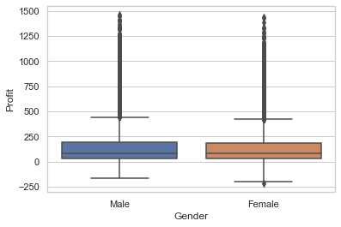
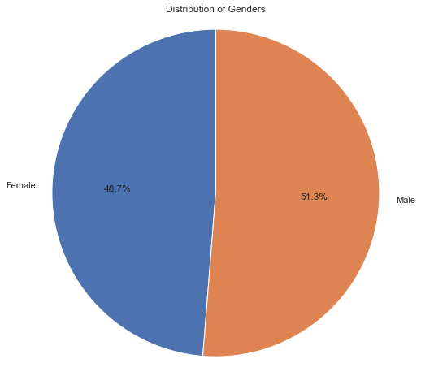
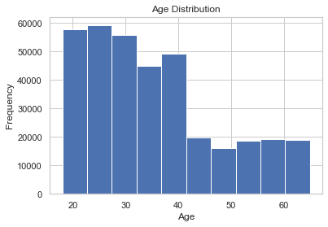
Customer Demographics
Customers are more Male than Female
Customers are more Young people(18-43 years old)
Gender has no impact on Profit

Slide 7
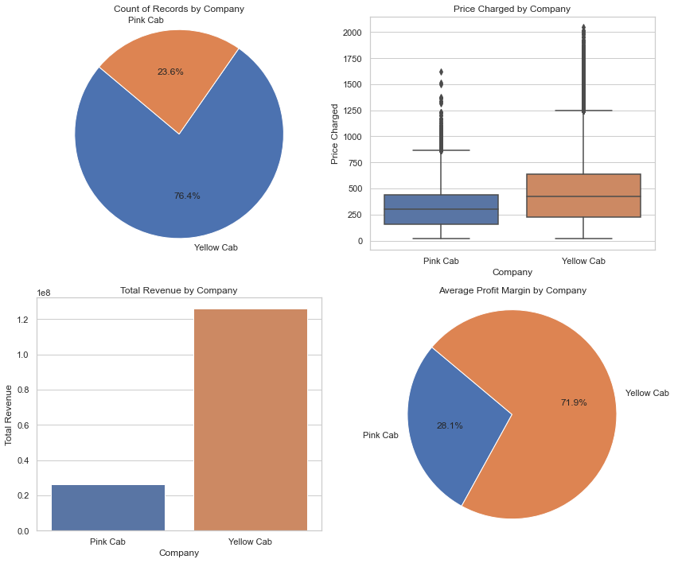
Market Share, Pricing, and Profitability
Yellow Cab has had 52.8% more rides than Pink Cab
Yellow Cab charged customer more than Pink Cab
Total revenue of Yellow Cab has been almost 50 times of Pink Cab
Yellow Cab has had 43.8% more average profit margin than Pink Cab

Slide 8
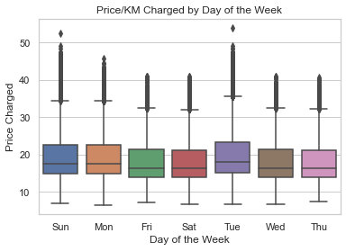
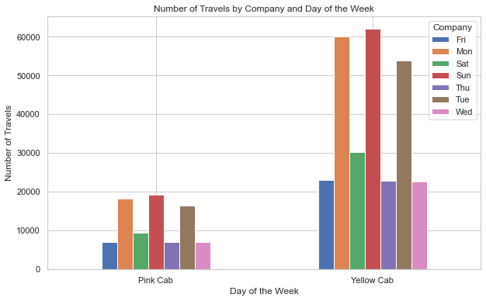
Seasonality and Pricing Strategies
Price/KM charged is higher on Tuesdays
For both Yellow Cab and Pink Cab, Sundays, Mondays, and Tuesdays have been busy days

Slide 9
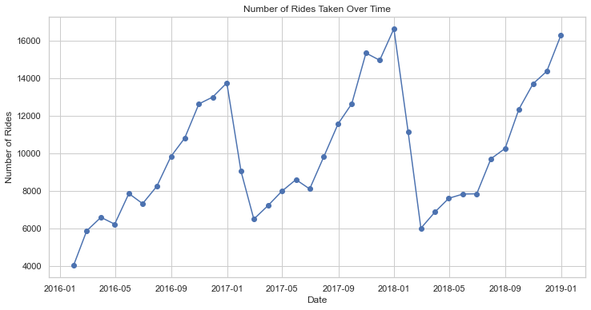
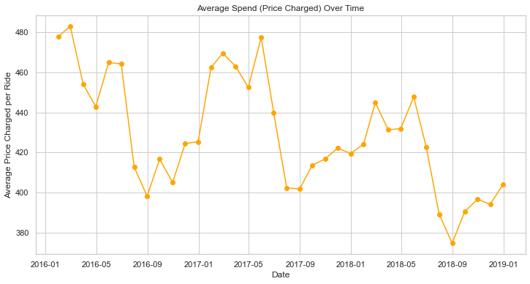
Seasonality is obvious in number of rides and Average Price Charged per Ride
Typically, when the number of rides increases during the fall, the average price charged per ride tends to decrease.
When the number of rides decreases during the spring and summer, the average price charged per ride tends to increase.

Slide 10
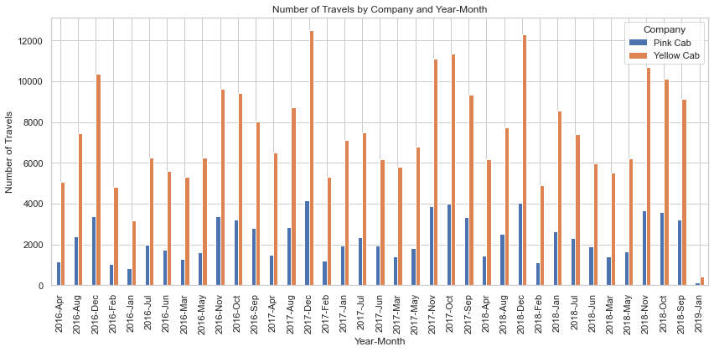
Both Yellow Cab and Pink Cab companies have highest number of rides in Dec, Nov, and Oct

Slide 11
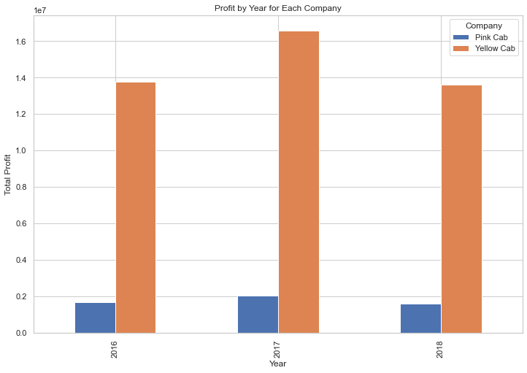
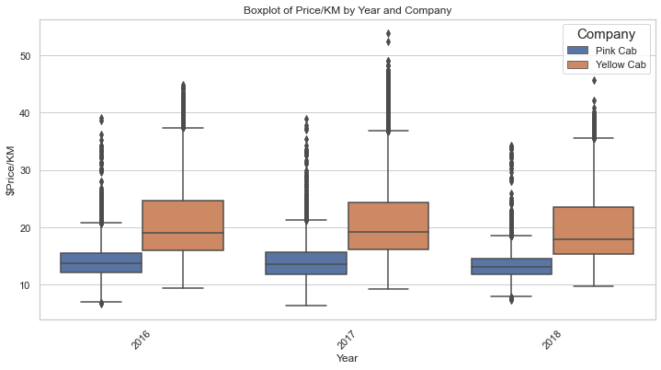
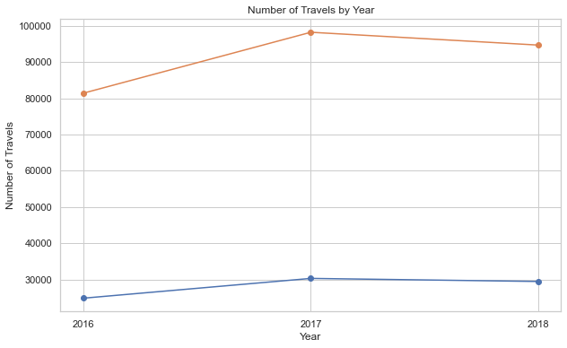
Both companies have highest total profit in 2017 and lowest total profit in 2018
Both company have highest number of travels in 2017 and lowest number of travels in 2016
Both companies have lowest price per KM in 2018, and lowest number of travels in 2016

Slide 12
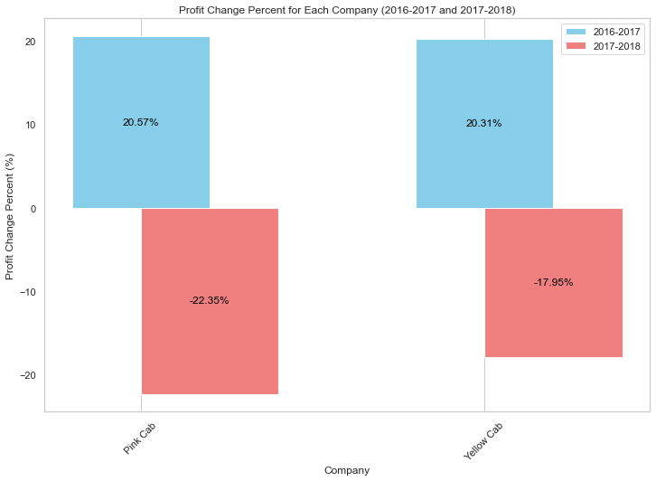
Yellow Cab has slightly lower profit gain from 2016 to 2017 in comparison with Pink Cab
Yellow Cab has lower profit lost (about %4.4) in comparison with Pink Cab from 2017 to 2018

Slide 13
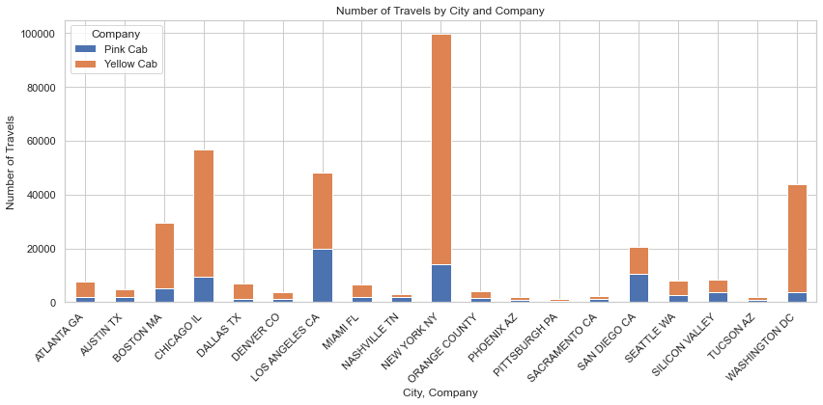
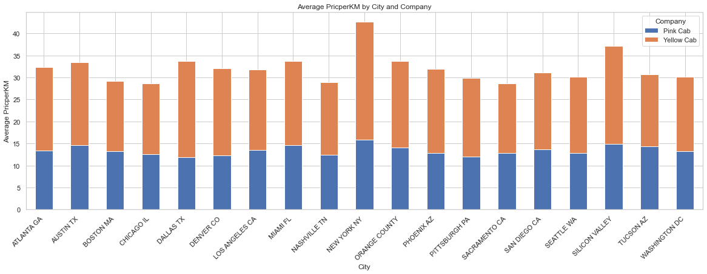
Geographical Insights
For Yellow Cab, the highest number of Travels and Average PriceperKM belong to NewYork NY
For Pink Cab, the highest number of Travels belongs to Los Angeles CA while the highest Average PriceperKM belongs to New York NY

Slide 14
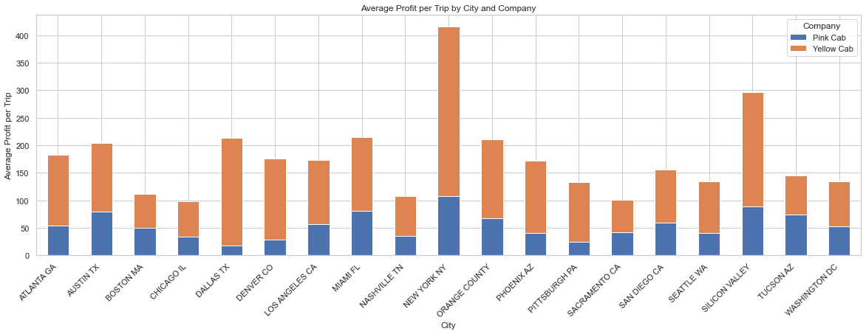
For both Yellow Cab and Pink Cab, the highest average profit belongs to New York NY

Slide 15
Top Cities for Cab Industry Profitability
City | Company | Total Profit | Profit per Capita | Average Profit per Ride
NEW YORK NY | Yellow Cab | 2.65e+07 | 3.15 | 264.82
WASHINGTON DC | Yellow Cab | 3.30e+06 | 7.88 | 75.43
LOS ANGELES CA | Yellow Cab | 3.29e+06 | 2.06 | 68.41
CHICAGO IL | Yellow Cab | 3.07e+06 | 1.57 | 54.19
NEW YORK NY | Pink Cab | 1.51e+06 | 0.18 | 15.13
BOSTON MA | Yellow Cab | 1.51e+06 | 6.05 | 50.74
LOS ANGELES CA | Pink Cab | 1.13e+06 | 0.71 | 23.44
DALLAS TX | Yellow Cab | 1.10e+06 | 1.17 | 157.33
SILICON VALLEY | Yellow Cab | 9.76e+05 | 0.83 | 114.62
SAN DIEGO CA | Yellow Cab | 9.49e+05 | 0.99 | 46.33
Yellow Cab tends to have higher profit per capita in most cities, implying a more efficient utilization of resources.
Washington DC has the highest profit per capita among all cities, indicating a potentially favorable market for taxi services.
Dallas TX stands out with a notably high average profit per ride for Yellow Cab.
Silicon Valley has relatively lower total profits but a higher profit per capita for Yellow Cab, indicating that the region may have a smaller market but with more profitability on a per-capita basis.

Slide 16
The models for Pink Cab show a stronger relationship between profit and the number of travels compared to the price per kilometer.
Regression Model Insights: Impact of Price and Number of Travels on Cab Company Profits
Model | R-squared | Adj. R-squared | P-value
Pink Cab - Profit ~ Price/KM | 0.292400 | 0.250776 | 1.682497e-02
Pink Cab - Profit ~ Number of Travels | 0.826329 | 0.816113 | 7.157402e-08
Yellow Cab - Profit ~ Price/KM | 0.492240 | 0.462371 | 8.149301e-04
Yellow Cab - Profit ~ Number of Travels | 0.761652 | 0.747632 | 1.093548e-06
For Yellow Cab, both predictors (price per kilometer and number of travels) have a significant impact on profit, with the number of travels being a particularly strong predictor.

Slide 17
EDA Summary
1- Market Overview:
The Cab industry in the US has shown remarkable growth in recent years, with multiple key players like Yellow Cab and Pink Cab.
2- Customer Demographics:
Customers in the industry are predominantly male and generally fall in the age range of 18-43 years.
3- Market Share and Pricing:
Yellow Cab has a significantly larger market share with 52.8% more rides than Pink Cab.
Yellow Cab charges higher prices and has nearly 50 times the revenue of Pink Cab.
4- Profitability:
Yellow Cab has a higher average profit margin (43.8%) compared to Pink Cab.
Both companies experienced the highest total profit in 2017 and the lowest in 2018.

Slide 18
5- Seasonality and Pricing Strategies:
Both companies exhibit seasonality, with higher ride numbers in fall and increased average prices during spring and summer.
Higher pricing per kilometer is observed on Tuesdays.
6- Geographical Insights:
For Yellow Cab, New York NY dominates in terms of rides, average price per kilometer, and average profit. While Dallas TX had the highest average profit per ride.
For Pink Cab, Los Angeles CA has the highest number of rides, while New York NY has the highest average price per kilometer and average profit.
7- Regression Model Insights: Impact of Price and Number of Travels on Cab Company Profits showed domination of travel frequency over price per kilometer for both companies.

Slide 19
Recommendations for XYZ Company
Market Entry: Consider entering the cab market, given its growth and profitability potential.
Focus on Demographics: Tailor services and marketing strategies to the predominant demographic of young males. This should be done with a commitment to fairness, inclusivity, and ethical business practices.
Competitive Pricing: Yellow Cab's success suggests exploring competitive pricing strategies to attract customers.
Seasonal Adaptation: Implement flexible pricing strategies based on seasonality to optimize revenue.
Geographical Expansion: New York NY seems promising for both companies; consider prioritizing efforts there.
Profit Optimization Strategy: Consider focusing on strategies that boost the number of travels, as it has a more significant impact on profit compared to price per kilometer. Tailor marketing and service offerings to attract a demographic that values frequent travels.

Slide 20
Thank You

